Slide 1




Peer Support:
– What it is
– What it does
– How to do it
Speaker: Edwin B. Fisher, Ph.D.
Global Director, Peers for Progress
Professor, Department of Health Behavior
Gillings School of Global Public Health
University of North Carolina – Chapel Hill
www.peerforprogress.org

Slide 2
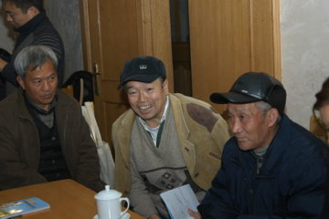

Peer Support in Anhui Province, China
Zhong Xuefeng, Institute of Health Education, Anhui Center for Disease Control
Older adults in Anhui Province, China
Group meetings led by peer
supporters and health center
staff
Addressed self management
and support
Informal support and shared activities through neighborhoods: shopping, exercise, fishing, etc.
Significant differences from controls on fasting glucose, 2 hr PPG, reported complications
Extended to CVD prevention/management by Anhui CDC
Zhong et al. Annals of Family Medicine 2015;13 Suppl 1:S50-8.
Peer Support: What it is – What it does – How to do it
www.peerforprogress.org
Speaker: Edwin B. Fisher, Ph.D

Slide 3
The Breadth of Peer Support
Informal support among family, friends, neighbors
Volunteers trained to provide specific support, for example, for new mothers
Trained Village Health Volunteers in Thailand
Staff Lady Health Workers in primary care in Pakistan
Mutual support groups such as for women with breast cancer
Online or text support
Peer Support: What it is – What it does – How to do it
www.peerforprogress.org
Speaker: Edwin B. Fisher, Ph.D

Slide 4
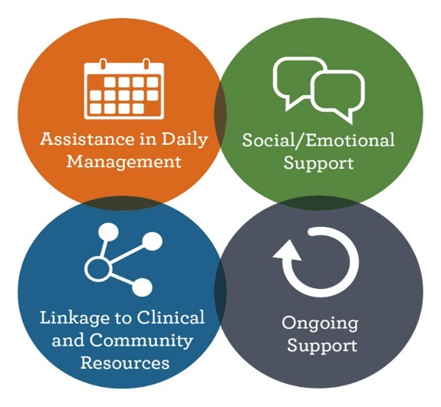
Four Key Functions of Peer Support
Peer Support: What it is – What it does – How to do it
www.peerforprogress.org
Speaker: Edwin B. Fisher, Ph.D

Slide 5
Peer Support Across the Prevention & Care Continuum
Appropriate
Treatment
Treatment to Target
Screening &
Diagnosis
Quality of Life
Secondary Prevention
Survivorship
Primary Prevention
Palliative & End-of-Life
Care
Peer Support
Peer Support: What it is – What it does – How to do it
www.peerforprogress.org
Speaker: Edwin B. Fisher, Ph.D

Slide 6
Strengths of Peer Supporters
Share perspectives, experience of those they help
People believe them because they are “like me”
Have time!!!
Peer Support: What it is – What it does – How to do it
www.peerforprogress.org
Speaker: Edwin B. Fisher, Ph.D

Slide 7
Why it Matters
Peer Support: What it is – What it does – How to do it
www.peerforprogress.org
Speaker: Edwin B. Fisher, Ph.D

Slide 8
Disease Management & Prevention – 8,760
8,766 = 24 X 365.25
6 hours a year in a doctor’s office or with other health professional.
8,760 hours “on your own”
  Healthy diet
  Physical activity
  Monitor status
  Take medications
  Manage sick days
  Manage stress – Healthy Coping
  Arrange medical appointments and testing
  Sleep
Peer Support: What it is – What it does – How to do it
www.peerforprogress.org
Speaker: Edwin B. Fisher, Ph.D

Slide 9
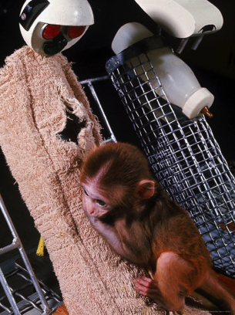
Fundamental Role of
Social Connections and Support
  Human beings are more effective and happier when they have someone
    they can talk to about personal matters
    who cares about them
    who can help them when they need help
The risk of death associated with social isolation is greater than the risk associated with cigarette smoking
Harlow, H.F., & Harlow, M. (1966) Learning to love. American Scientist 54: 244-272.
House, Landis & Umberson. Science, 1988 241: 540-544.
Holt-Lunstad, Smith, & Layton PLOSMedicine, 2010, 7: July e1000316 www.plosmedicine.org
Peer Support: What it is – What it does – How to do it
www.peerforprogress.org
Speaker: Edwin B. Fisher, Ph.D

Slide 10
Emerging Results
from Peers for Progress Projects
2009: 8 Evaluation and 6 Demonstration Projects in 9 countries on 6 continents
(Ann Fam Med. 2015;13 Suppl 1:S2-8).
Peer Support: What it is – What it does – How to do it
www.peerforprogress.org
Speaker: Edwin B. Fisher, Ph.D

Slide 11
Emerging Results
from Projects
Feasibility
Reach,
Engagement
Efficacy
Effectiveness
Sustainability
Adoption
Implemented in all 14 project sites
Mean baseline HbA1c = 8.92%
Improved HbA1c, BMI, BP, QOL
Uganda, South Africa without funding; ⬆ participation
WellMed extends from 15 to all 23 sites
NHS in UK extends to additional regions
Fisher et al. Ann Fam Med. 2015;13 Suppl 1:S2-8.
Cost Effective!!
Fisher et al., Ann Rev Public Health, 2014 35: 363-383.
Peer Support: What it is – What it does – How to do it
www.peerforprogress.org
Speaker: Edwin B. Fisher, Ph.D

Slide 12
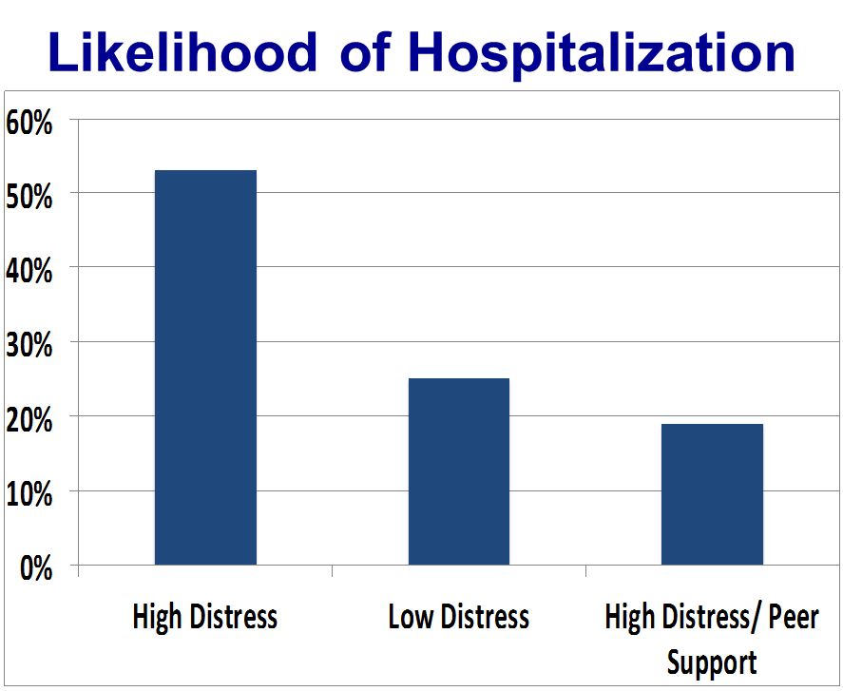
Strategic Considerations
(Fisher et al., Health Affairs, 2015 34: 1523-30)
Engaging “Hardly Reached”:
Peer Support Reached Over 85% of
  Low income, immigrant adults with diabetes
  Single mothers of children hospitalized for asthma
  Systematic review: 94% successful
  (Sokol et al, AJPH, 2016, 1541-0048)
Reaching Populations
  7 Compañeros reached 3,787
  Improved blood sugar
Integrating Behavioral
Health and Peer Support
  Reduced distress as well as
  hospitalization in Hong Kong
  (Chan et al. JAMA Internal Med, 2014 174: 972-981)
Peer Support: What it is – What it does – How to do it
www.peerforprogress.org
Speaker: Edwin B. Fisher, Ph.D

Slide 13
Peer Support in CVD
Systematic review (including Heart Failure, prevention, focus on diet, exercise, PA, BP; Fisher et al., Health Affairs, 2015)
  9/10 showed positive benefits of peer support
Example: Cardiac Rehab (Clark, Euro J Cardio Nursing, 2011)
  Peer support by former patients to promote physical activity
  At 12-months, program members reported sustained physical activity
  Those who did not participate reported significant decline of 211 min of physical activity per week
Peer Support: What it is – What it does – How to do it
www.peerforprogress.org
Speaker: Edwin B. Fisher, Ph.D

Slide 14
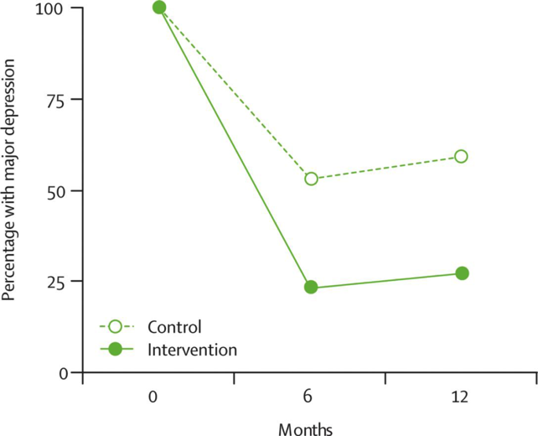
“Lady Health Workers” in Pakistan Reduce Post-Partum Depression
“Lady Health Workers”
Completed 2ndry education
Responsible for ≈ 100 households
Primarily general health education and preventive maternal and child care
Extending to TB and HIV detection and control
≈ 96,000 LHWs cover 80% of Pakistan rural population
Manual based intervention, “Thinking Healthy Programme”
  Promote change in thoughts likely to increase depression
  Practical problem solving
  Collaboration with family
Rahman et al.
Lancet 2008 372: 902-909
Arch Womens Ment Health 2007 10: 211-219.
Peer Support: What it is – What it does – How to do it
www.peerforprogress.org
Speaker: Edwin B. Fisher, Ph.D

Slide 15
Example from Rahman’s Lady Health Worker Intervention for Post-Partum Depression
“… case where poverty and the husband’s chronic unemployment were an underlying issue in the mother’s depression, the LHW used CBT techniques to motivate her to take a small loan from the government’s micro-credit scheme. The money was used to purchase a buffalo to sell its milk for profit (the LHW had personal experience of such a venture and was able to guide her). The woman was able to return the loan, gained tangibly from the intervention, both materially and in self-worth and confidence, and this led to marked improvement in her depressive symptoms”
Rahman, A. Challenges and opportunities in developing a psychological intervention for perinatal depression in rural Pakistan – a multi-method study. Archive of Women’s Mental Health.
2007 10: 211-219. p 217.
Peer Support: What it is – What it does – How to do it
www.peerforprogress.org
Speaker: Edwin B. Fisher, Ph.D

Slide 16
Importance of Emotional Support
"When I knew I had diabetes, I felt that my life is meaningless. When I joined the peer support program, I found that many people have the same illness as me, but they lived very well. Some are more than 80 years old. This encouraged me. I also can live long and healthy. “
(61-year-old female, Anhui Province)
"I feel that the 'Peer Group' is like my second family. Normally, I did not like to talk about my illness with other people, but in here I can talk about my disease. We also discussed diet, activities, medicine and blood sugar control.......“
(66-year-old female, Anhui Province)
Peer Support: What it is – What it does – How to do it
www.peerforprogress.org
Speaker: Edwin B. Fisher, Ph.D

Slide 17
How to do it
Peer Support: What it is – What it does – How to do it
www.peerforprogress.org
Speaker: Edwin B. Fisher, Ph.D

Slide 18
Peer Support Modes
Peer Supporters as part of community based organization, linked with clinical providers
Individual, trained peer supporters offer assistance, coaching, “being there”
Group classes and support sessions
  Community classes for prevention, support of ongoing CVD rehab
  Group Medical Visits
Mutual-help groups
  May be self governing
  Experienced leaders are important
Peer Supporters based in and extenders of group programs
Outreach, patient engagement, and self management/education from community and/or clinical organizations
Peer Supporter as part of service provider team
Peer Supporters working as “extenders” and under supervision of Social Workers or Care Managers
Peer Support: What it is – What it does – How to do it
www.peerforprogress.org
Speaker: Edwin B. Fisher, Ph.D

Slide 19
Recruiting Peer Supporters
Considerations:
Time available
Enjoy talking with others
Do not see people’s problems as simple; no “easy answers”
Able to learn and teach basic disease management or health promotion behaviors
Willing to use back up support from professionals
Volunteer? – Depends on specific duties, requirements
Share key features with those they serve – specific disease, life stage, neighborhood, culture???
Sources
Clinical providers
Community organizations
Others?
Peer Support: What it is – What it does – How to do it
www.peerforprogress.org
Speaker: Edwin B. Fisher, Ph.D

Slide 20
Training Peer Supporters
Goal is to be able to help others implement their management plan
Don’t need skills of nurse or dietitian
So, training is to knowledge of an individual who understands their health problems well
Teach skills for
  Simple counseling (active listening, motivational interviewing)
  Promoting behavior change, e.g., problem solving
Peer Support: What it is – What it does – How to do it
www.peerforprogress.org
Speaker: Edwin B. Fisher, Ph.D

Slide 21
Implementing the Program
How will peer supporters be paired with participants?
How many participants will each peer supporter manage?
How will peer supporters contact each participant (e.g., face-to-face, phone, group)?
How often will peer supporters contact each participant?
Will peer supporters follow a set curriculum with participants or will content be flexible?
Peer Support: What it is – What it does – How to do it
www.peerforprogress.org
Speaker: Edwin B. Fisher, Ph.D

Slide 22
Management of Peer Support Program
Clearly identified manager of program
Back up plan
  Questions, issues peer supporter cannot answer/handle
  Prompt response to individuals’ questions
Ongoing support for supporters
  Weekly meeting
  Share questions and discuss problems
  Emotional support for difficulties encountered
Monitoring and supervision
  Because of the importance of the work, not mistrust
  Tone: improvement, not surveilance
Peer Support: What it is – What it does – How to do it
www.peerforprogress.org
Speaker: Edwin B. Fisher, Ph.D

Slide 23
Quality Control, Misinformation??
Key: Peer supporter is basically a good person wanting to help people who often face serious obstacles
  Will use accessible resources
Emphasize promoting good information rather than trying to control or police information
Select peer supporters who are willing to be part of a team
Clarify: key role is support and assistance, not professional expertise
Key is monitoring, back up, support for the peer supporter
  24/7 contact for peer supporters (titrate according to, e.g., routine, need within 24h, emergency)
  Becomes major value added – peer supporter can get authoritative answers to questions
Peer Support: What it is – What it does – How to do it
www.peerforprogress.org
Speaker: Edwin B. Fisher, Ph.D

Slide 24
Program Evaluation
Not scientific research
“Common sense” assessment:
  Whether things happened as expected
  Whether objectives were achieved
Can be quantitative and statistical or just counting and descriptive
Purpose:
  Guide program improvement
  Document value of program
Peer Support: What it is – What it does – How to do it
www.peerforprogress.org
Speaker: Edwin B. Fisher, Ph.D

Slide 25
Program Evaluation – Example
Objective | What Happened
Develop curriculum for high CVD risk and post Myocardial Infarction healthy lifestyle | 3 cardiologists and health educator from local university helped develop curriculum
Recruit and train 10 supporters | Recruited 12 8 completed training
Identify 50 High Risk or post Myocardial Infarction Paatients | Clinicians said they had “hundreds” but only able to identify 30
Engage 80% of eligible individuals for > 3 months | Engage 90% of eligible post Myocardial Infarction but only 50% of eligible high risk individuals
80% sustained smoking cessation in post Myocardial Infarction | 83% sustained smoking cessation in post Myocardial Infarction
80% report 150 minutes exercise per week | 72% report 150 minutes exercise per week
Average BP of < 130/90 through medication or lifestyle | Average BP of 128/92; 128/85 in high risk and 128/95 in post Myocardial Infarction
Peer Support: What it is – What it does – How to do it
www.peerforprogress.org
Speaker: Edwin B. Fisher, Ph.D

Slide 26

Comprehensive – from initial program planning to ongoing sustainability and quality improvement
Flexible – no “one size fits all” but live links (at http://goo.gl/66FiHf) to varied resources for each step of the way, planning, training, evaluation, etc.
Peer Support: What it is – What it does – How to do it
www.peerforprogress.org
Speaker: Edwin B. Fisher, Ph.D

Slide 27
Collaborative Networking
Working together to share experiences, program models, evaluations, advocacy
Sharing resources:
  Global: models, materials, approaches, protocols
  Local: training, enrichment, back-up???
Advantages
  Legitimization through recognition that program is part of regional or global trend
  Resources, stimulus for quality improvement
  Energizing of staff – and peer supporters
Modes: videoconference, web, meetings, other?
Products: key protocols, evaluation tools, position papers, other?
Peer Support: What it is – What it does – How to do it
www.peerforprogress.org
Speaker: Edwin B. Fisher, Ph.D

Slide 28
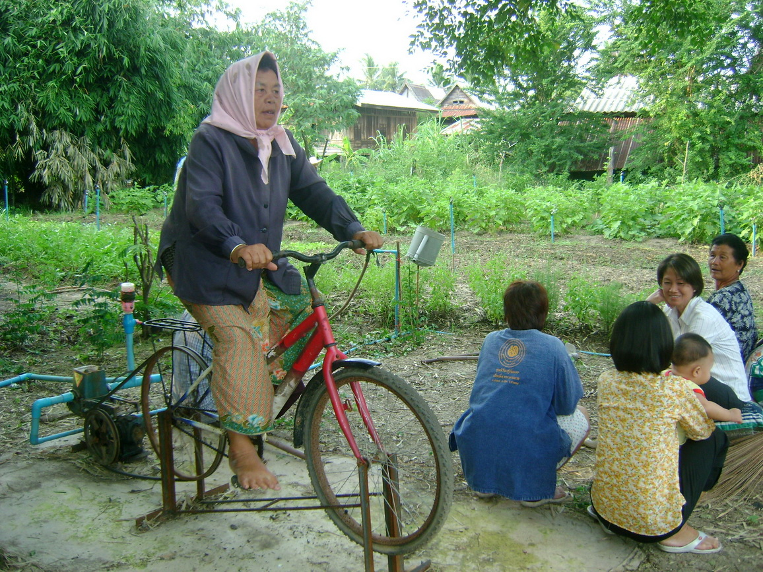
Peer Support: What it is – What it does – How to do it
www.peerforprogress.org
Speaker: Edwin B. Fisher, Ph.D

Slide 29

Peer Support: What it is – What it does – How to do it
www.peerforprogress.org
Speaker: Edwin B. Fisher, Ph.D

Slide 30
Thank you
Peer Support: What it is – What it does – How to do it
www.peerforprogress.org
Speaker: Edwin B. Fisher, Ph.D

